Slide 1
Sales Insights
Tableau Presentation
(Database-MySQL)

Slide 2
Problem Statement
ABC is a hardware company and peripheral manufacturer
Market is growing dynamically and sales director is having problem in tracking sales in different regions
He is curious to have proper sales insights
No proper view on sales is provided by regional sales managers
There are lots of files shared by regional managers whenever sales director asks for the insight
It’s difficult to go through all the excel files and understand the situation

Slide 3
Goal
To have a simple, understandable and visualization sales insight
To make data driven decision from the output
To unlock sales insights that are not visible before sales team for decision support and automate them to reduce manual time spent in data gathering

Slide 4
Output/End Result
An automated dashboard using Tableau providing quick and latest sales insights in order to support data driven decision making

Slide 5
End Result OLD VERSION (Before Stakeholders Review)

Slide 6
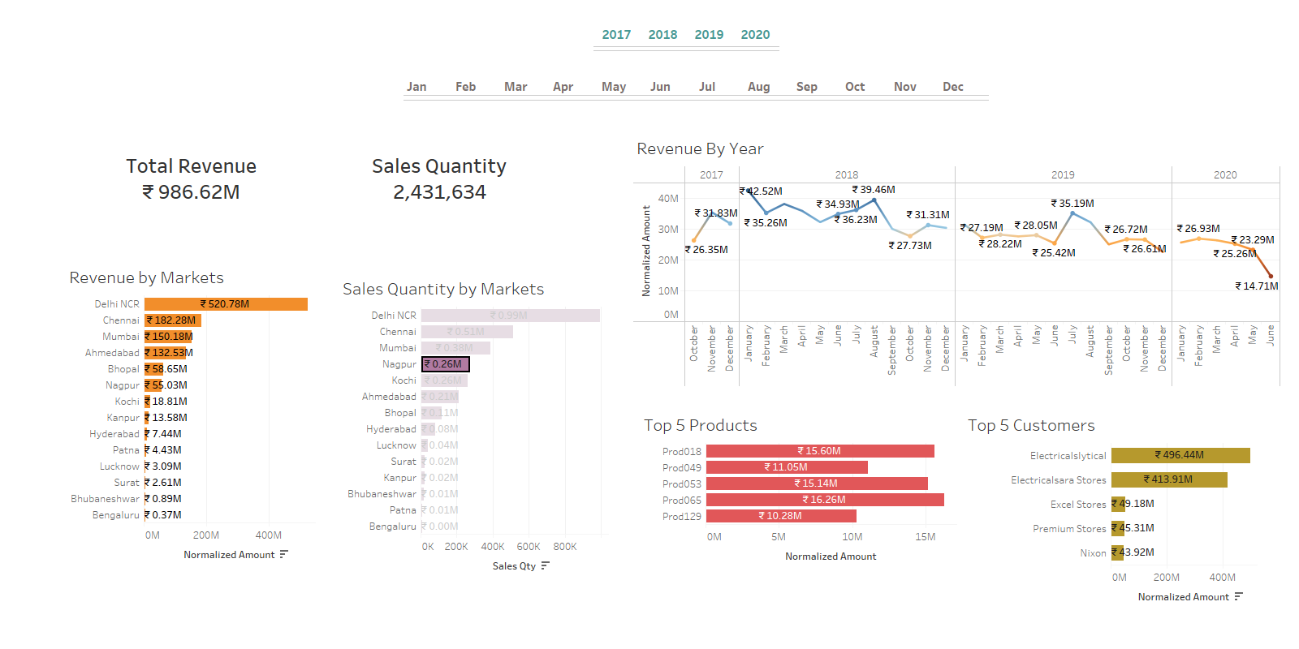

Slide 7
End Result NEW VERSION (After Stakeholders Review)

Slide 8
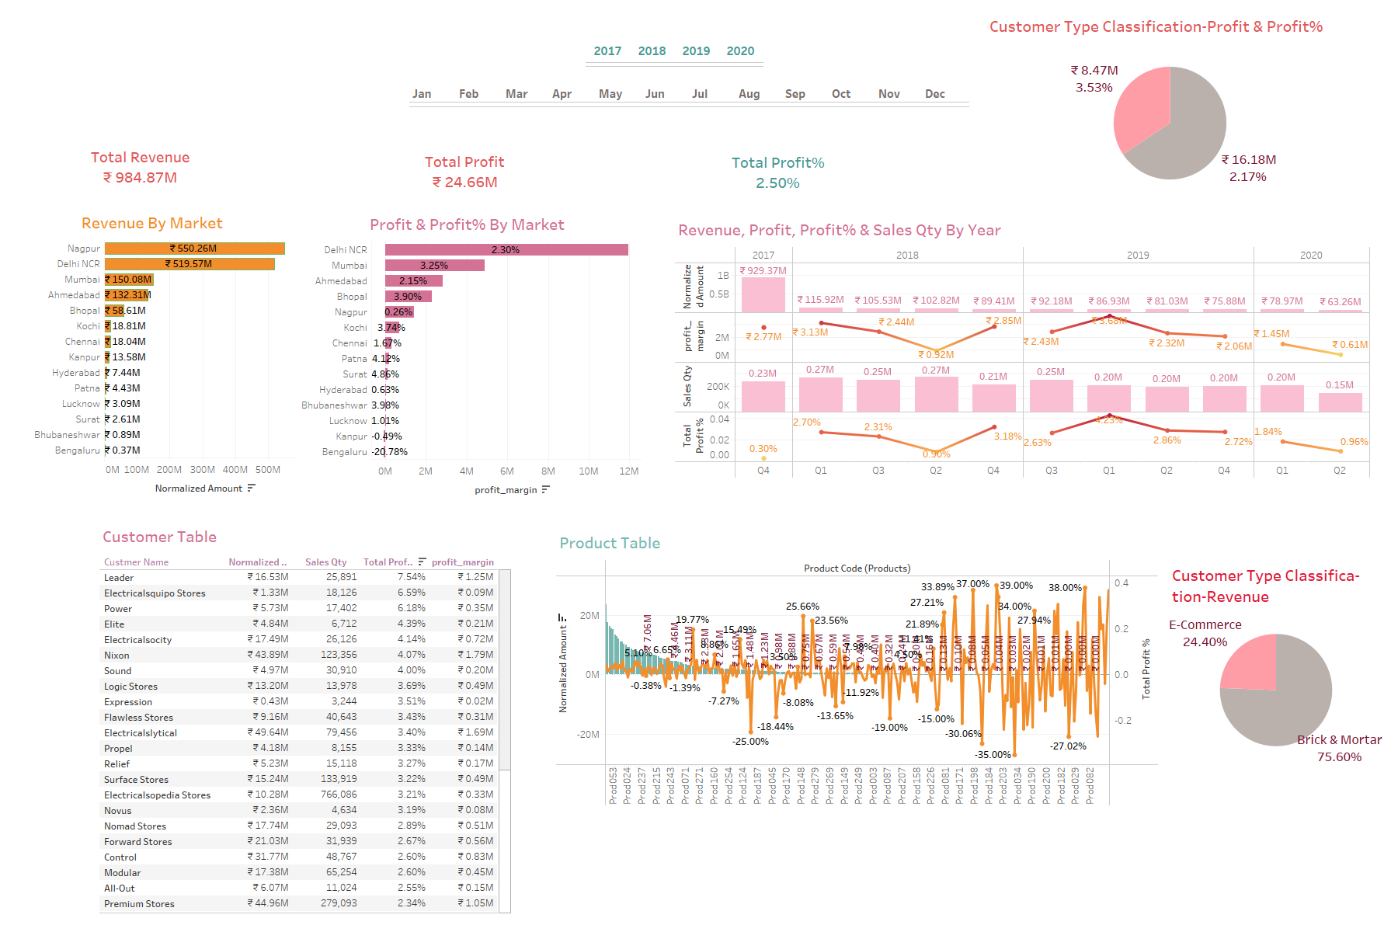

Slide 9
Year-Wise Data Representation

Slide 10
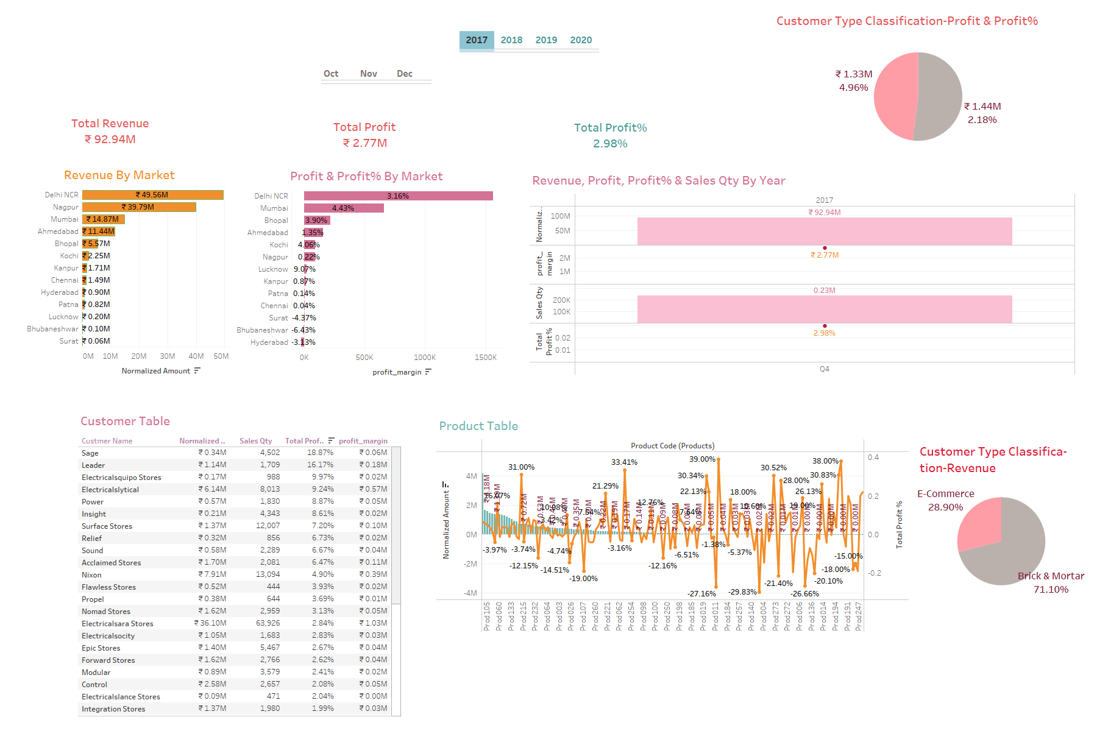

Slide 11
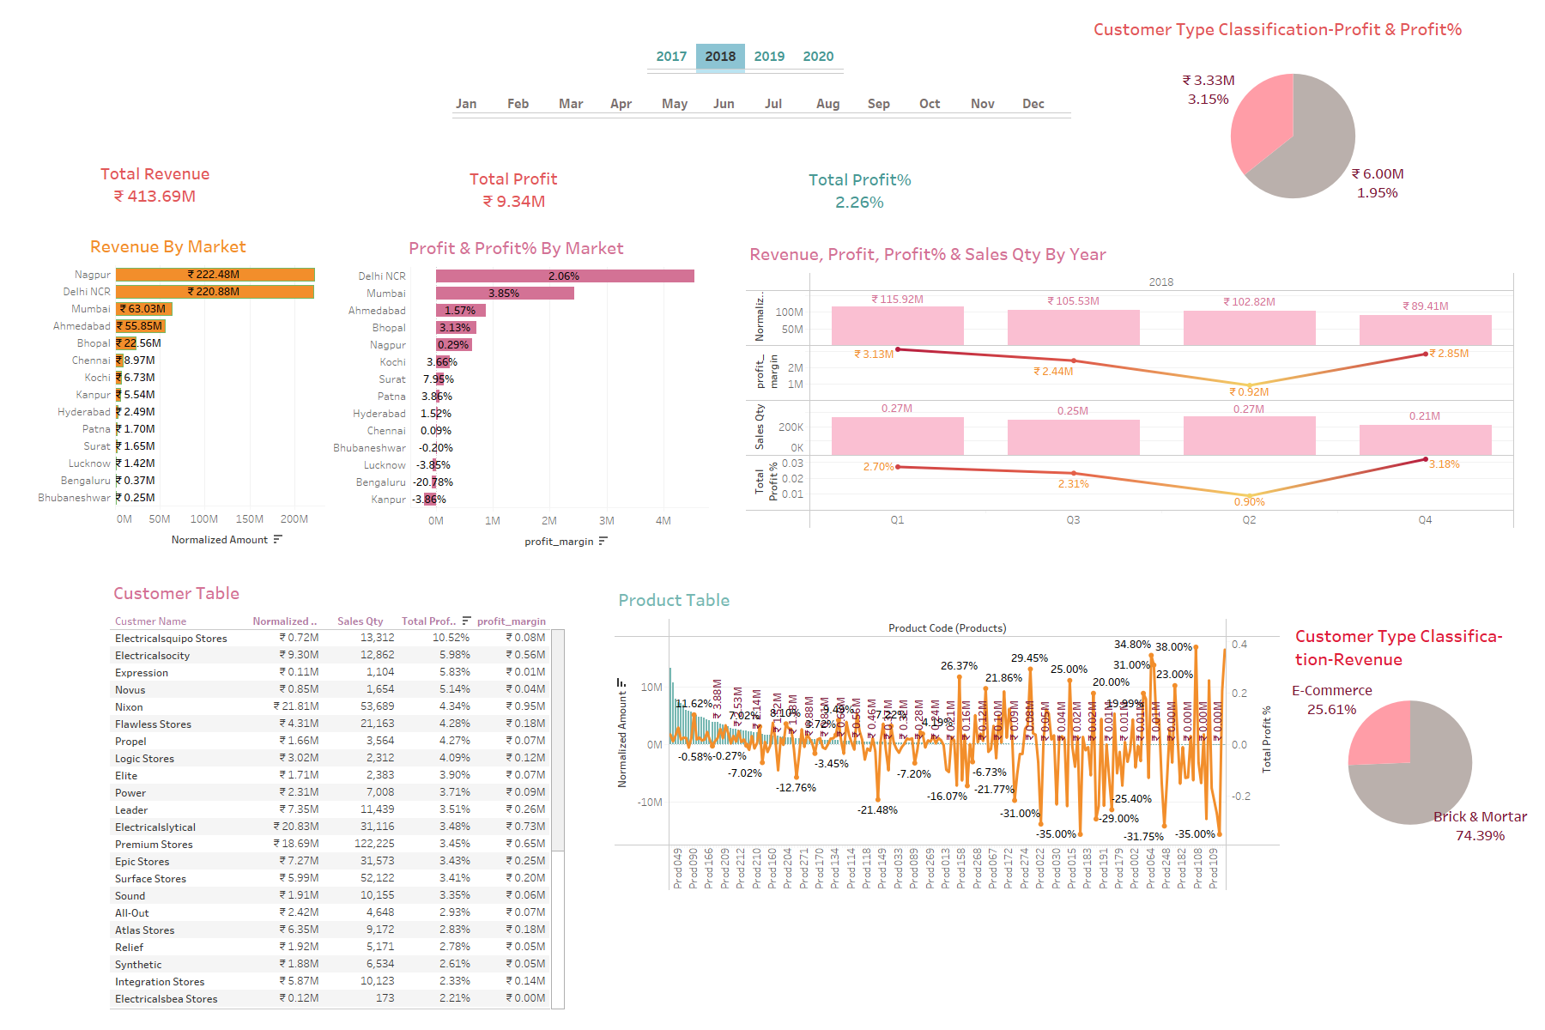

Slide 12
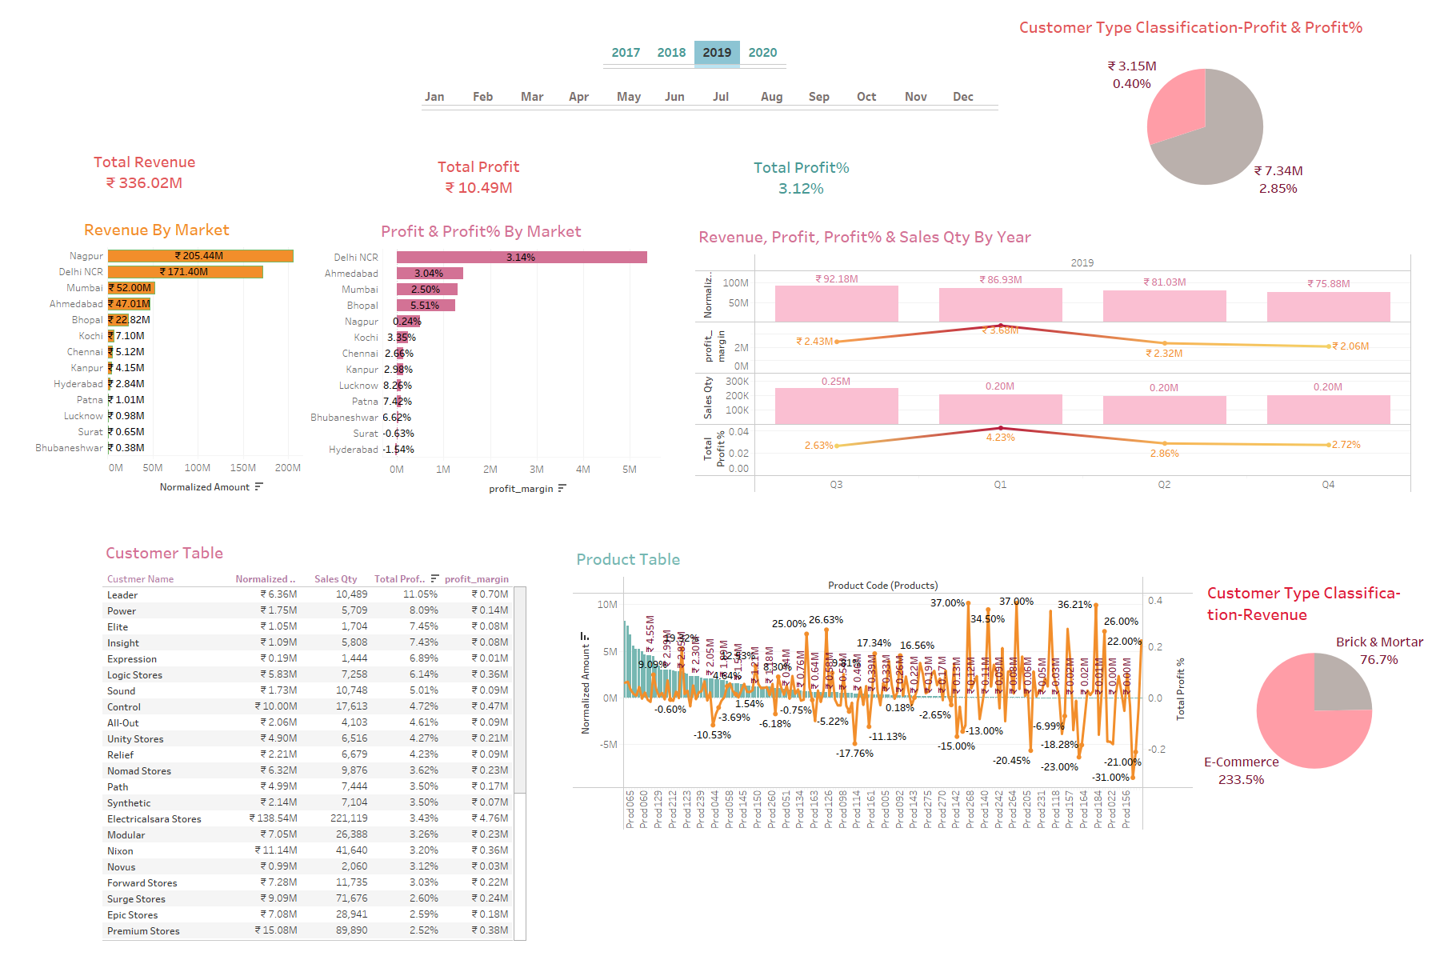

Slide 13
